Slide 1

Where is my Dozer ?
This is what happens when things get lost and they turn up in the most unexpected places.

Slide 2
First of all …..
You have a big Tonka Toy called
The Ultimate Earth Mover

Slide 3


Ultimate Earth Mover
This is the largest earth mover
in the world.....
built by the German company, Krupp,
and seen here crossing a federal highway
in Germany
en route to its destination
(an open-pit coal mine).
It is cheaper to move the thing like this,
than to construct or reassemble onsite.

Slide 4
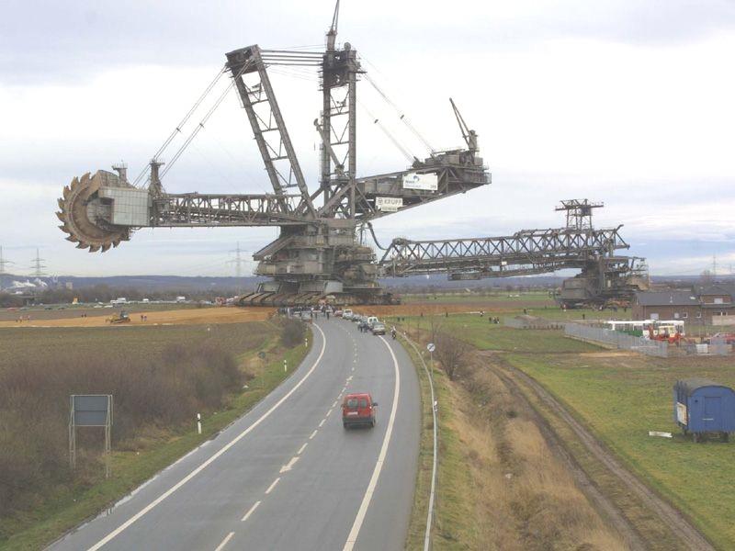

Slide 5
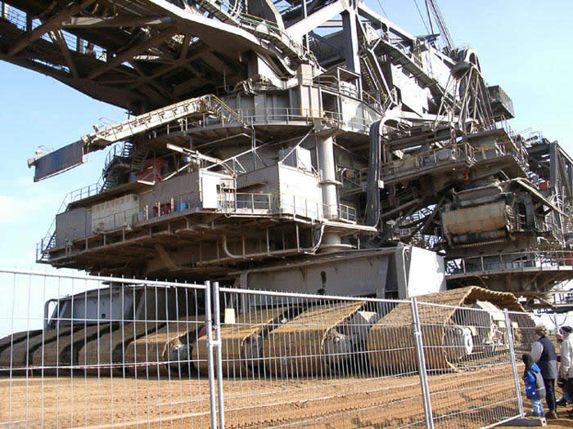

Slide 6
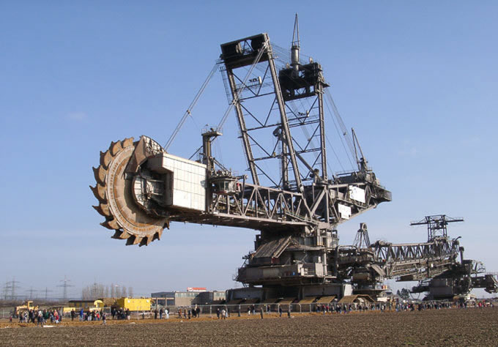

Slide 7
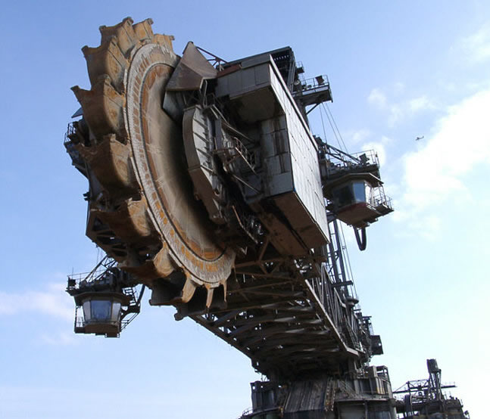

Slide 8
Specifications:
~ The mover stands 311 feet tall and 705 feet long.
~ It weighs over 45,500 tons
~ Cost $100 million to build
~ Took 5 years to design and manufacture
~ 5 years to assemble.
~ Requires 5 people to operate it.
~ The Bucket Wheel is over 70 feet in diameter with 20 buckets,
each of which can hold over 530 cubic feet of material.
~ A 6-foot man can stand up inside one of the buckets.
~ It moves on 12 crawlers
(each is 12 feet wide, 8' high and 46 feet long).
There are 8 crawlers in front and 4 in back.
It has a maximum speed of 1 mile in 3 hours (1/3 mile/hour).
~ It can remove over 76,455 cubic meters each day.
(100,000 large dump trucks at 40yds. each)

Slide 9
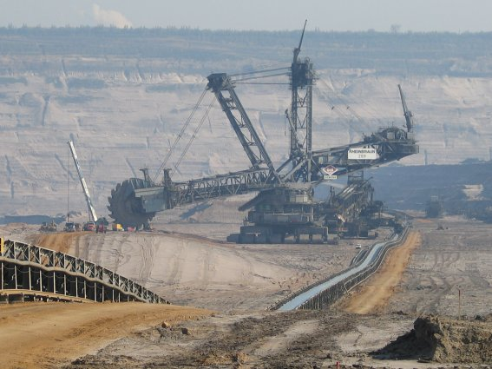

Slide 10

Now where is that Dozer ?

Slide 11

Ahhh … There it is

Slide 12

At the top of that big wheel !!

Slide 13
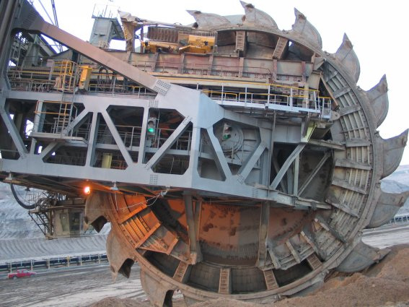

Slide 14
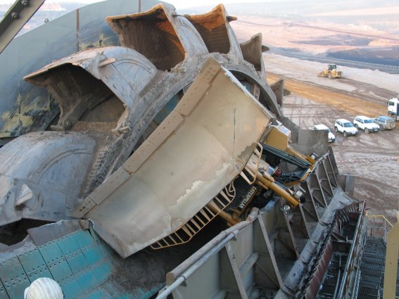

Slide 15
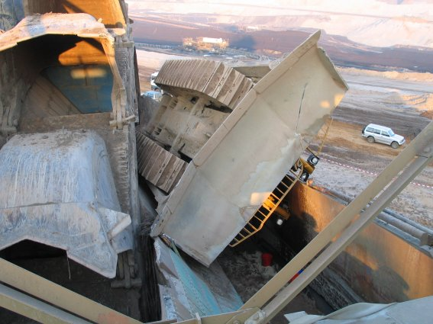

Slide 16
